Slide 1
Machine Translation
Dr. Alaa Sheta

Slide 2
Announcements
We are taking attendance today
Sign in with the TAs outside the auditorium
No need to get up now – there will be plenty of time to sign in after the lecture ends
For attendance policy special cases, see Piazza post for clarification
Assignment 4 content covered today
Get started early! The model takes 4 hours to train!
Mid-quarter feedback survey:
Will be sent out sometime in the next few days (watch Piazza).
Complete it for 0.5% credit
2

Slide 3
Overview
Today we will:
Introduce a new task: Machine Translation
is a major use-case of
Introduce a new neural architecture: sequence-to-sequence
is improved by
Introduce a new neural technique: attention
3

Slide 4
Section 1: Pre-Neural Machine Translation
4

Slide 5
Machine Translation
Machine Translation (MT) is the task of translating a sentence x from one language (the source language) to a sentence y in another language (the target language).
x:
L'homme est né libre, et partout il est dans les fers
y:
Man is born free, but everywhere he is in chains
- Rousseau
5

Slide 6
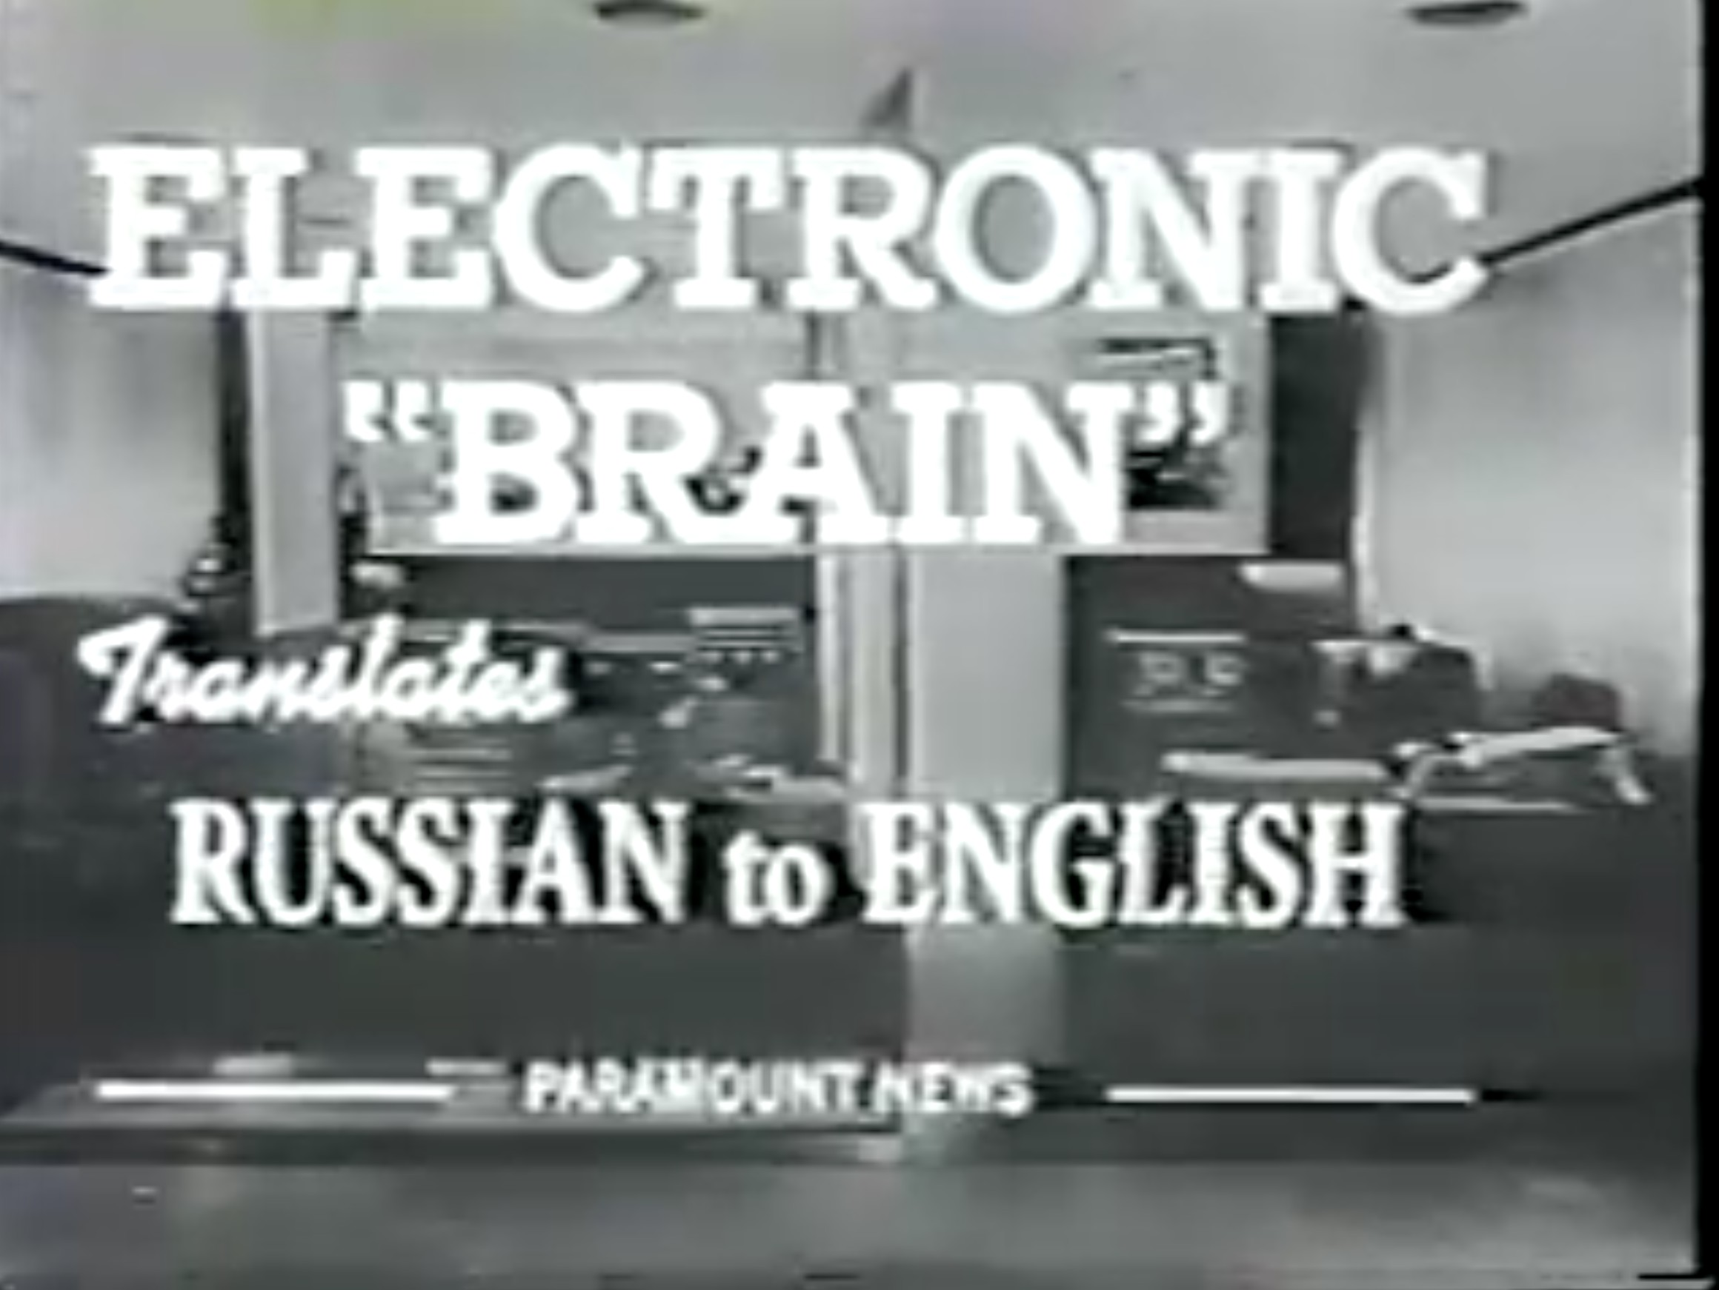
1950s: Early Machine Translation
Machine Translation research began in the early 1950s.
Russian → English (motivated by the Cold War!)
1 minute video showing 1954 MT:
https://youtu.be/K-HfpsHPmvw
•
Systems were mostly rule-based, using a bilingual dictionary to map Russian words to their English counterparts
6

Slide 7
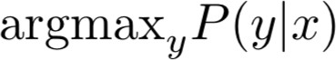
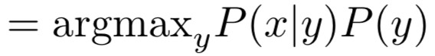
1990s-2010s: Statistical Machine Translation
Core idea: Learn a probabilistic model from data
Suppose we’re translating French → English.
We want to find best English sentence y, given French sentence
x
Use Bayes Rule to break this down into two components to be learnt separately:
Translation Model
Models how words and phrases should be translated (fidelity).
Learnt from parallel data.
Language Model
Models how to write good English (fluency). Learnt from monolingual data.
7

Slide 8
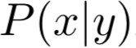
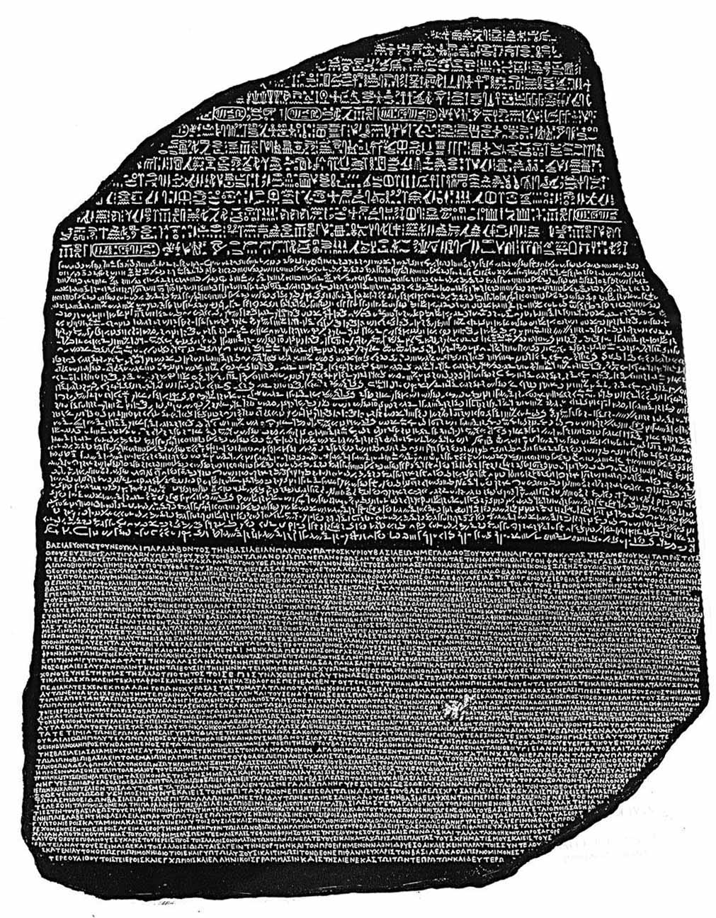
1990s-2010s: Statistical Machine Translation
Question: How to learn translation model ?
First, need large amount of parallel data
(e.g. pairs of human-translated French/English sentences)
The Rosetta Stone
Ancient Egyptian
Demotic
Ancient Greek
8

Slide 9
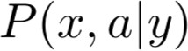
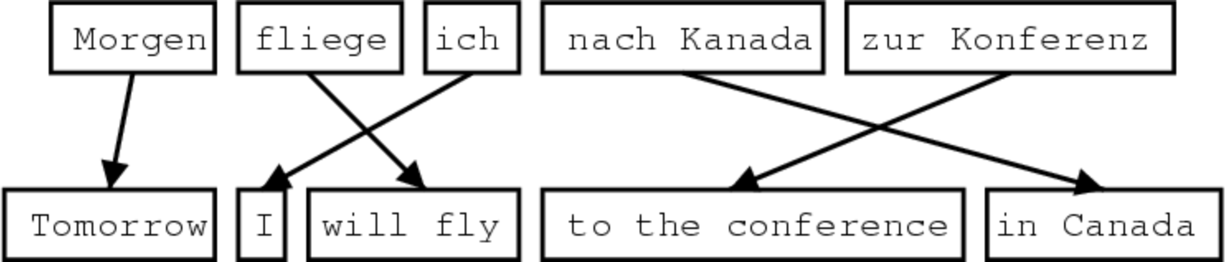
Learning alignment for SMT
Question: How to learn translation model the parallel corpus?
from
Break it down further: Introduce latent a variable into the model:
where a is the alignment, i.e. word-level correspondence between source sentence x and target sentence y
9

Slide 10
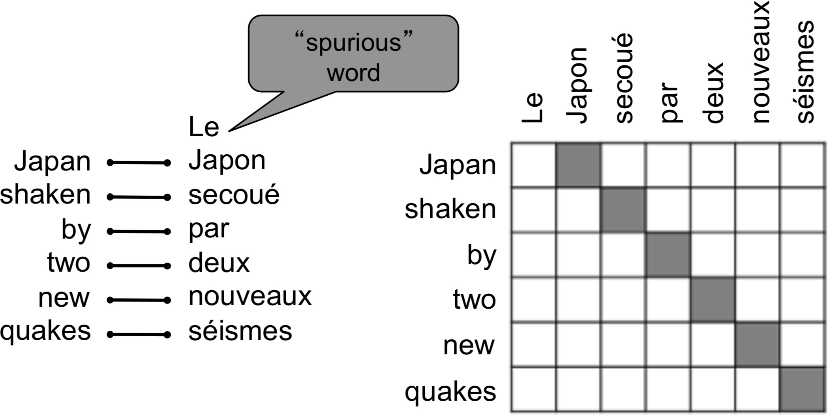
What is alignment?
Alignment is the correspondence between particular words in the translated sentence pair.
Typological differences between languages lead to complicated alignments!
Note: Some words have no counterpart
Examples from: “The Mathematics of Statistical Machine Translation: Parameter Estimation", Brown et al, 1993. http://www.aclweb.org/
anthology/J93-2003

Slide 11
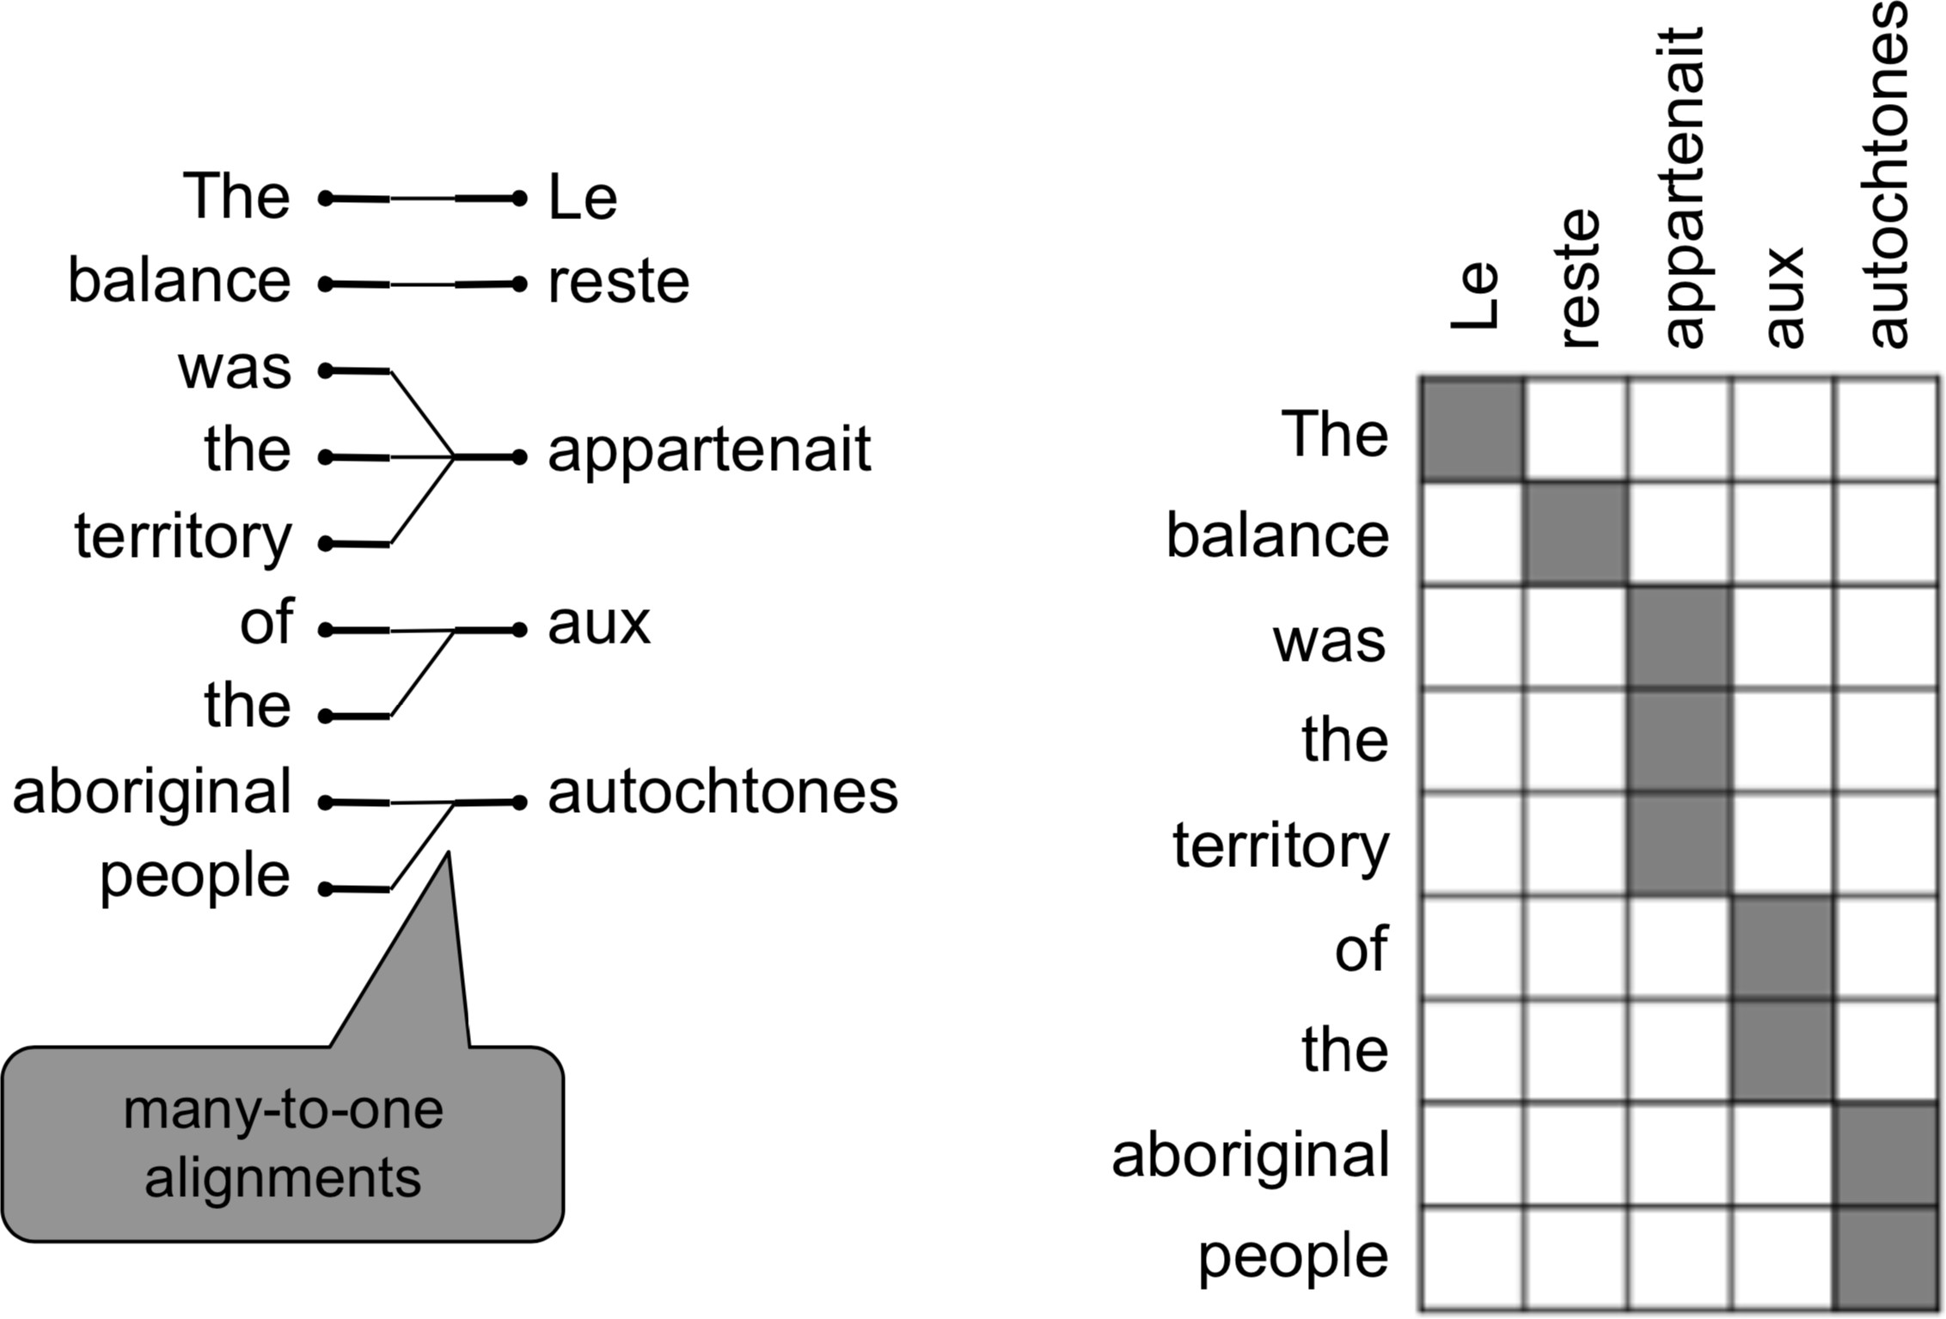
Alignment is complex
Alignment can be many-to-one
Examples from: “The Mathematics of Statistical Machine Translation: Parameter Estimation", Brown et al, 1993. http://www.aclweb.org/
anthology/J93-2003

Slide 12
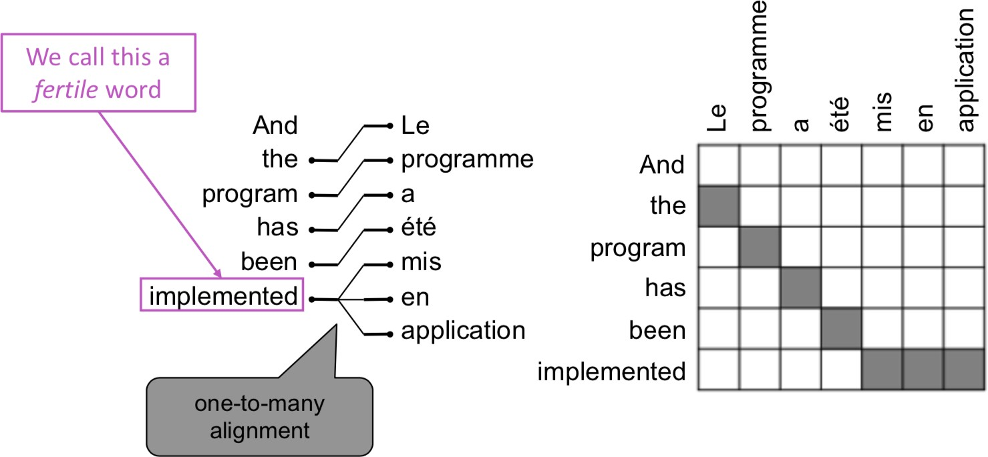
Alignment is complex
Alignment can be one-to-many
12
Examples from: “The Mathematics of Statistical Machine Translation: Parameter Estimation", Brown et al, 1993. http://www.aclweb.org/
anthology/J93-2003

Slide 13
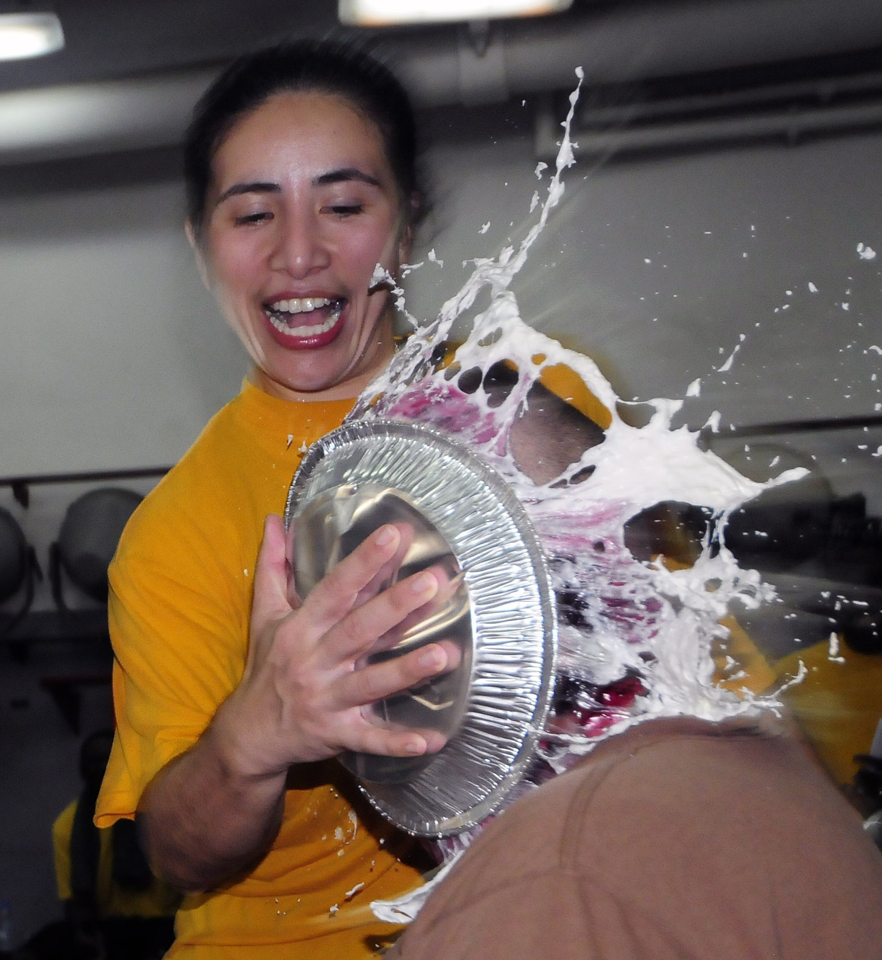
Alignment is complex
Some words are very fertile!
he hit me with a pie
il a m’
he hit me with a pie
il
a m’ entarté
entarté
This word has no single- word equivalent in English
13

Slide 14
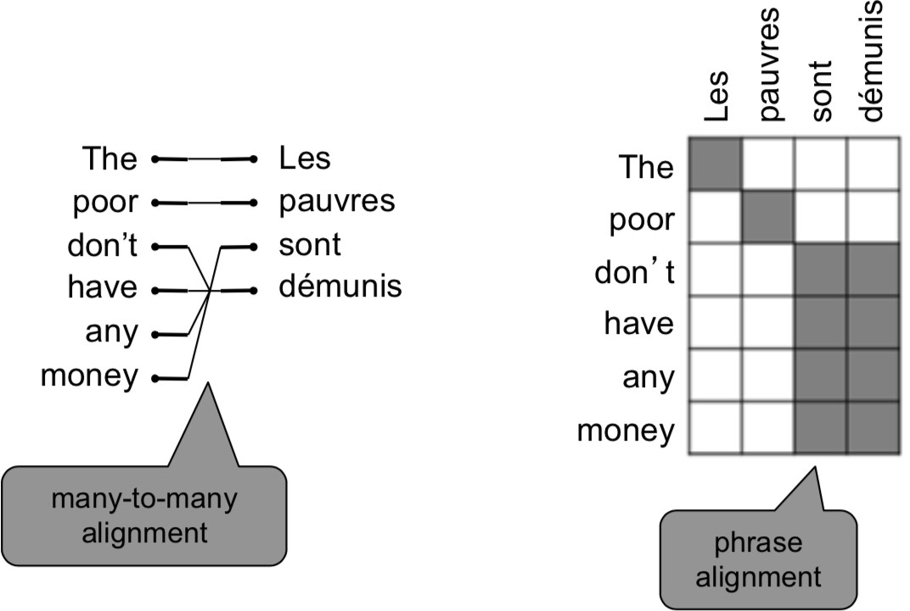
Alignment is complex
Alignment can be many-to-many (phrase-level)
14
Examples from: “The Mathematics of Statistical Machine Translation: Parameter Estimation", Brown et al, 1993. http://www.aclweb.org/
anthology/J93-2003

Slide 15
Learning alignment for SMT
We learn as a combination of many factors, including:
Probability of particular words aligning (also depends on position in sent)
Probability of particular words having particular fertility (number of corresponding words)
etc.
Alignments a are latent variables: They aren’t explicitly specified in the data!
Require the use of special learning aglos (like Expectation- Maximization) for learning the parameters of distributions with latent variables (CS 228)
•

Slide 16
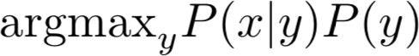
Decoding for SMT
Language Model
Question:
How to compute this argmax?
Translation
Model
We could enumerate every possible y and calculate the probability? → Too expensive!
Answer: Impose strong independence assumptions in model, use dynamic programming for globally optimal solutions (e.g. Viterbi algorithm).
This process is called decoding

Slide 17
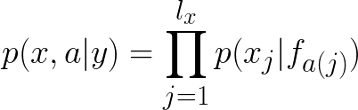

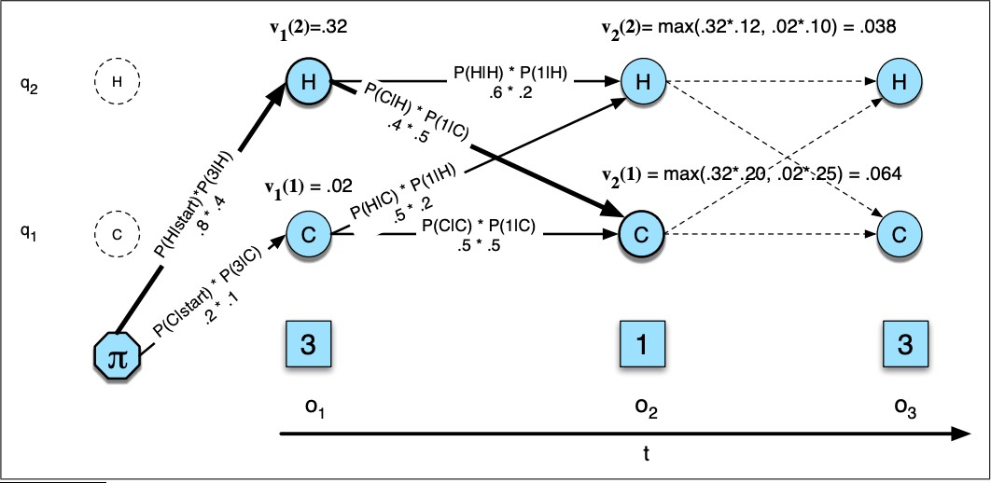
Viterbi: Decoding with Dynamic Programming
Impose strong independence assumptions in model:
Source: “Speech and Language Processing", Chapter A, Jurafsky and Martin, 2019.

Slide 18
1990s-2010s: Statistical Machine Translation
SMT was a huge research field
The best systems were extremely complex
Hundreds of important details we haven’t mentioned here
Systems had many separately-designed subcomponents
Lots of feature engineering
Need to design features to capture particular language phenomena
Require compiling and maintaining extra resources
Like tables of equivalent phrases
Lots of human effort to maintain
Repeated effort for each language pair!

Slide 19
Section 2: Neural Machine Translation

Slide 20
What is Neural Machine Translation?
Neural Machine Translation (NMT) is a way to do Machine Translation with a single neural network
The neural network architecture is called sequence-to- sequence (aka seq2seq) and it involves two RNNs.

Slide 21
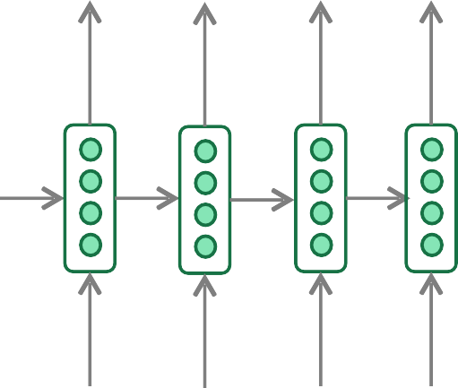
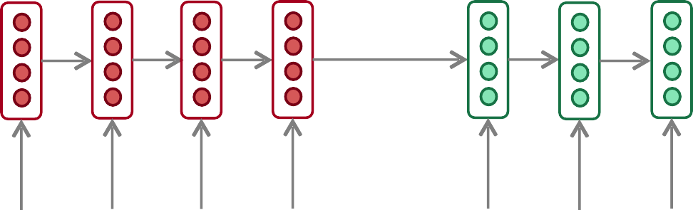





Neural Machine Translation (NMT)
The sequence-to-sequence model
Encoding of the source sentence.
Provides initial hidden state for Decoder RNN.
Target sentence (output)
he hit me
with a
pie <END>
argmax
argmax
argmax
argmax
argmax
argmax
argmax
Encoder RNN
Decoder RNN
il
a
m’ entarté
<START> he
hit me
with a
pie
Source sentence (input)
Decoder RNN is a Language Model that generates target sentence, conditioned on encoding.
Encoder RNN produces an encoding of the source sentence.
Note: This diagram shows test time behavior: decoder output is fed in as next step’s input

Slide 22
Sequence-to-sequence is versatile!
Sequence-to-sequence is useful for more than just MT
Many NLP tasks can be phrased as sequence-to-sequence:
Summarization (long text → short text)
Dialogue (previous utterances → next utterance)
Parsing (input text → output parse as sequence)
Code generation (natural language → Python code)

Slide 23
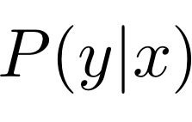
Neural Machine Translation (NMT)
The sequence-to-sequence model is an example of a
Conditional Language Model.
Language Model because the decoder is predicting the next word of the target sentence y
Conditional because its predictions are also conditioned on the source sentence x
NMT directly calculates :
Probability of next target word, given target words so far and source
sentence x
Question: How to train a NMT system?
Answer: Get a big parallel corpus…

Slide 24
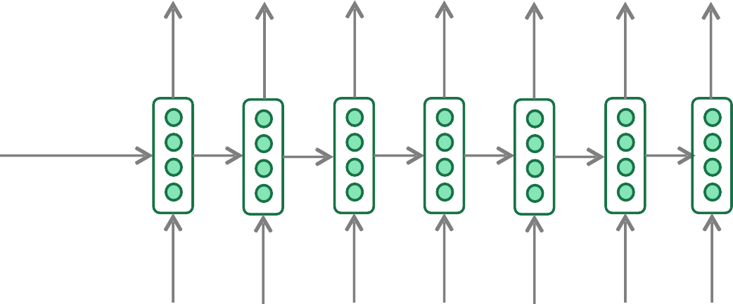
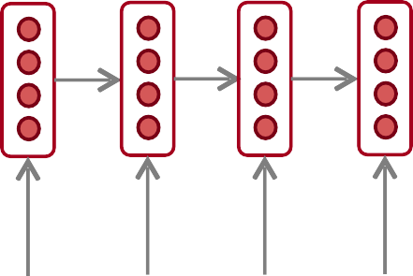
Training a Neural Machine Translation system
= negative log prob of “he”
= negative log prob of “with”
= negative log prob of <END>
+ 𝐽₆ +𝐽₇
_{𝐽 =} 1
𝑇
𝐽
=
𝐽₁ + 𝐽₂ +
𝐽₃ + + 𝐽₅
_{𝑇} ∑
𝑡
𝐽₄
𝑡=1
_{𝑦}^₁
_{𝑦}^₂
_{𝑦}^_{3 𝑦}^
_{𝑦}^₅
_{𝑦}^₆
_{𝑦}^₇
4
Encoder RNN
Decoder RNN
il a m’ entarté
Source sentence (from corpus)
<START> he hit me with a
Target sentence (from corpus)
pie
Seq2seq is optimized as a single system.
Backpropagation operates “end-to-end”.
24

Slide 25

Greedy decoding
We saw how to generate (or “decode”) the target sentence by taking argmax on each step of the decoder
he hit
me with a
pie <END>
argmax
argmax
argmax
argmax
argmax
argmax
argmax
<START> he hit me with a
This is greedy decoding (tak^{p}e^{ie}most probable word on each step)
Problems with this method?
•
•

Slide 26
Problems with greedy decoding
Greedy decoding has no way to undo decisions!
Input: il a m’entarté (he hit me with a pie)
→ he
→ he hit
→ he hit a
(whoops! no going back now…)
How to fix this?

Slide 27
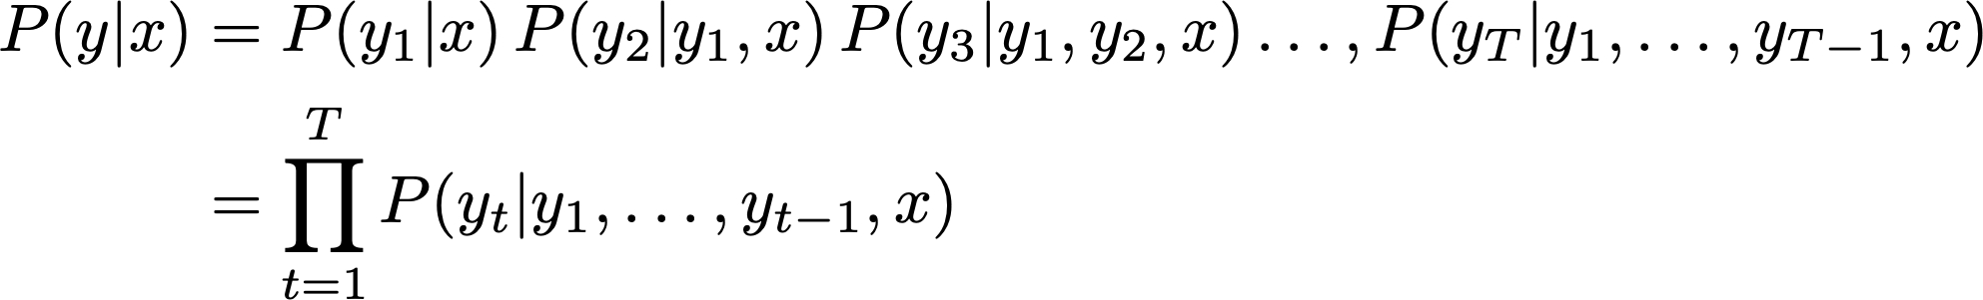
Exhaustive search decoding
Ideally we want to find a (length T) translation y that maximizes
We could try computing all possible sequences y
This means that on each step t of the decoder, we’re tracking V^{t} possible partial translations, where V is vocab size
This O(V^{T}) complexity is far too expensive!

Slide 28
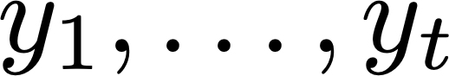
Beam search decoding
Core idea: On each step of decoder, keep track of the k most probable partial translations (which we call hypotheses)
k is the beam size (in practice around 5 to 10)
A hypothesis has a score which is its log probability:
Scores are all negative, and higher score is better
We search for high-scoring hypotheses, tracking top k on each step
Beam search is not guaranteed to find optimal solution
But much more efficient than exhaustive search!

Slide 29
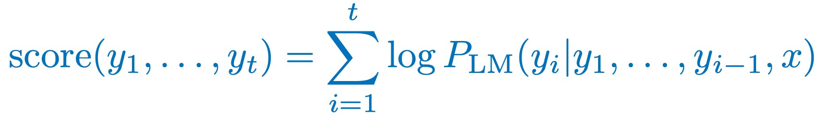
Beam search decoding: example
Beam size = k = 2. Blue numbers =
<START>
Calculate prob dist of next word
29

Slide 30
Beam search decoding: example
Beam size = k = 2. Blue numbers =
-0.7 = log P_{LM}(he|<START>)
he
<START>
I
-0.9 = log P_{LM}(I|<START>)
Take top k words and compute scores
30

Slide 31
Beam search decoding: example
Beam size = k = 2. Blue numbers =
-1.7 = log P_{LM}(hit|<START> he) + -0.7
-0.7
hit
he
struck
-2.9= log P_{LM}(struck|<START> he) + -0.7
-1.6= log P_{LM}(was|<START> I) + -0.9
<START>
was
I
got
-0.9
-1.8= log P_{LM}(got|<START> I) + -0.9
For each of the k hypotheses, find top k next words and calculate scores
31

Slide 32
Beam search decoding: example
Beam size = k = 2. Blue numbers =
-1.7
-0.7
hit
he
struck
-2.9
<START>
-1.6
was
I
got
-0.9
-1.8
Of these k² hypotheses, just keep k with highest scores
32

Slide 33
Beam search decoding: example
Beam size = k = 2. Blue numbers =
-2.8 = log P_{LM}(a|<START> he hit) + -1.7
-1.7
a
-0.7
hit
he
me
struck
-2.5 = log P_{LM}(me|<START> he hit) + -1.7
-2.9
<START>
-2.9 = log P_{LM}(hit|<START> I was) + -1.6
-1.6
hit
was
I
struck
got
-0.9
-3.8 = log P (struck|<START> I was) + -1.6
LM
-1.8
For each of the k hypotheses, find top k next words and calculate scores
33

Slide 34
Beam search decoding: example
Beam size = k = 2. Blue numbers =
-2.8
-1.7
a
-0.7
hit
he
me
struck
-2.5
-2.9
<START>
-2.9
-1.6
hit
was
I
struck
got
-0.9
-3.8
-1.8
Of these k² hypotheses, just keep k with highest scores
34

Slide 35
Beam search decoding: example
Beam size = k = 2. Blue numbers =
-4.0
tart
-2.8
pie
-1.7
a
-0.7
hit
-3.4
-3.3
he
me
struck
-2.5
with
-2.9
<START>
-2.9
on
-1.6
hit
-3.5
was
I
struck
got
-0.9
-3.8
-1.8
For each of the k hypotheses, find top k next words and calculate scores
35

Slide 36
Beam search decoding: example
Beam size = k = 2. Blue numbers =
-4.0
tart
-2.8
pie
-1.7
a
-0.7
hit
-3.4
-3.3
he
me
struck
-2.5
with
-2.9
<START>
-2.9
on
-1.6
hit
-3.5
was
I
struck
got
-0.9
-3.8
-1.8
Of these k² hypotheses, just keep k with highest scores
36

Slide 37
Beam search decoding: example
Beam size = k = 2. Blue numbers =
-4.0
-4.8
tart
in
-2.8
pie
with
-1.7
a
-3.4
-3.3
-4.5
-3.7
-0.7
hit
he
me
struck
-2.5
with
a
-2.9
<START>
-2.9
on
one
-1.6
hit
-3.5
-4.3
was
I
struck
got
-0.9
-3.8
-1.8
For each of the k hypotheses, find top k next words and calculate scores
37

Slide 38
Beam search decoding: example
Beam size = k = 2. Blue numbers =
-4.0
-4.8
tart
in
-2.8
pie
with
-1.7
a
-3.4
-3.3
-4.5
-3.7
-0.7
hit
he
me
struck
-2.5
with
a
-2.9
<START>
-2.9
on
one
-1.6
hit
-3.5
-4.3
was
I
struck
got
-0.9
-3.8
-1.8
Of these k² hypotheses, just keep k with highest scores
38

Slide 39
Beam search decoding: example
Beam size = k = 2. Blue numbers =
-4.0
-4.8
tart
in
-2.8
-4.3
pie
with
-1.7
a
pie
-3.4
-3.3
-4.5
-3.7
-0.7
hit
he
me
tart
struck
-2.5
with
a
-4.6
-2.9
<START>
-2.9
on
one
-5.0
-1.6
hit
pie
-3.5
-4.3
was
I
struck
tart
got
-0.9
-3.8
-5.3
-1.8
For each of the k hypotheses, find top k next words and calculate scores
39

Slide 40
Beam search decoding: example
Beam size = k = 2. Blue numbers =
-4.0
-4.8
tart
in
-2.8
-4.3
pie
with
-1.7
a
pie
-3.4
-3.3
-4.5
-3.7
-0.7
hit
he
me
tart
struck
-2.5
with
a
-4.6
-2.9
<START>
-2.9
on
one
-5.0
-1.6
hit
pie
-3.5
-4.3
was
I
struck
tart
got
-0.9
-3.8
-5.3
-1.8
40
This is the top-scoring hypothesis!

Slide 41
Beam search decoding: example
Beam size = k = 2. Blue numbers =
-4.0
-4.8
tart
in
-2.8
-4.3
pie
with
-1.7
a
pie
-3.4
-3.3
-4.5
-3.7
-0.7
hit
he
me
tart
struck
-2.5
with
a
-4.6
-2.9
<START>
-2.9
on
one
-5.0
-1.6
hit
pie
-3.5
-4.3
was
I
struck
tart
got
-0.9
-3.8
-5.3
-1.8
41
Backtrack to obtain the full hypothesis

Slide 42
Beam search decoding: stopping criterion
In greedy decoding, usually we decode until the model produces a <END> token
For example: <START> he hit me with a pie <END>
In beam search decoding, different hypotheses may produce <END> tokens on different timesteps
When a hypothesis produces <END>, that hypothesis is complete.
Place it aside and continue exploring other hypotheses via beam search.
Usually we continue beam search until:
We reach timestep T (where T is some pre-defined cutoff), or
We have at least n completed hypotheses (where n is pre-defined cutoff)

Slide 43
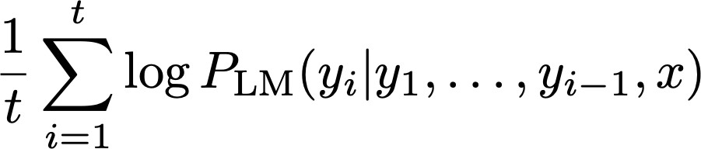
Beam search decoding: finishing up
We have our list of completed hypotheses.
How to select top one with highest score?
Each hypothesis on our list has a score
Problem with this: longer hypotheses have lower scores
Fix: Normalize by length. Use this to select top one instead:

Slide 44
Advantages of NMT
Compared to SMT, NMT has many advantages:
Better performance
More fluent
Better use of context
Better use of phrase similarities
A single neural network to be optimized end-to-end
No subcomponents to be individually optimized
Requires much less human engineering effort
No feature engineering
Same method for all language pairs

Slide 45
Disadvantages of NMT?
Compared to SMT:
NMT is less interpretable
Hard to debug
NMT is difficult to control
For example, can’t easily specify rules or guidelines for translation
Safety concerns!

Slide 46

How do we evaluate Machine Translation?
BLEU (Bilingual Evaluation Understudy)
You’ll see BLEU in detail in Assignment 4!
BLEU compares the machine-written translation to one or several human-written translation(s), and computes a similarity score based on:
n-gram precision (usually for 1, 2, 3 and 4-grams)
Plus a penalty for too-short system translations
BLEU is useful but imperfect
There are many valid ways to translate a sentence
So a good translation can get a poor BLEU score because it has low n-gram overlap with the human translation ☹
46
Source: ”BLEU: a Method for Automatic Evaluation of Machine Translation", Papineni et al, 2002. http://aclweb.org/anthology/P02-1040

Slide 47
MT progress over time
[Edinburgh En-De WMT newstest2013 Cased BLEU; NMT 2015 from U. Montréal]
27
Phrase-based SMT Syntax-based SMT Neural MT
20.3
13.5
6.8
0
2013
2014
2015
2016
47
Source: http://www.meta-net.eu/events/meta-forum-2016/slides/09_sennrich.pdf

Slide 48

MT progress over time
48

Slide 49
NMT: the biggest success story of NLP Deep Learning
Neural Machine Translation went from a fringe research activity in 2014 to the leading standard method in 2016
2014: First seq2seq paper published
2016: Google Translate switches from SMT to NMT
This is amazing!
SMT systems, built by hundreds of engineers over many years, outperformed by NMT systems trained by a handful of engineers in a few months
49

Slide 50
So is Machine Translation solved?
Nope!
Many difficulties remain:
Out-of-vocabulary words
Domain mismatch between train and test data
Maintaining context over longer text
Low-resource language pairs
Further reading: “Has AI surpassed humans at translation? Not even close!”
https://www.skynettoday.com/editorials/state_of_nmt
50

Slide 51
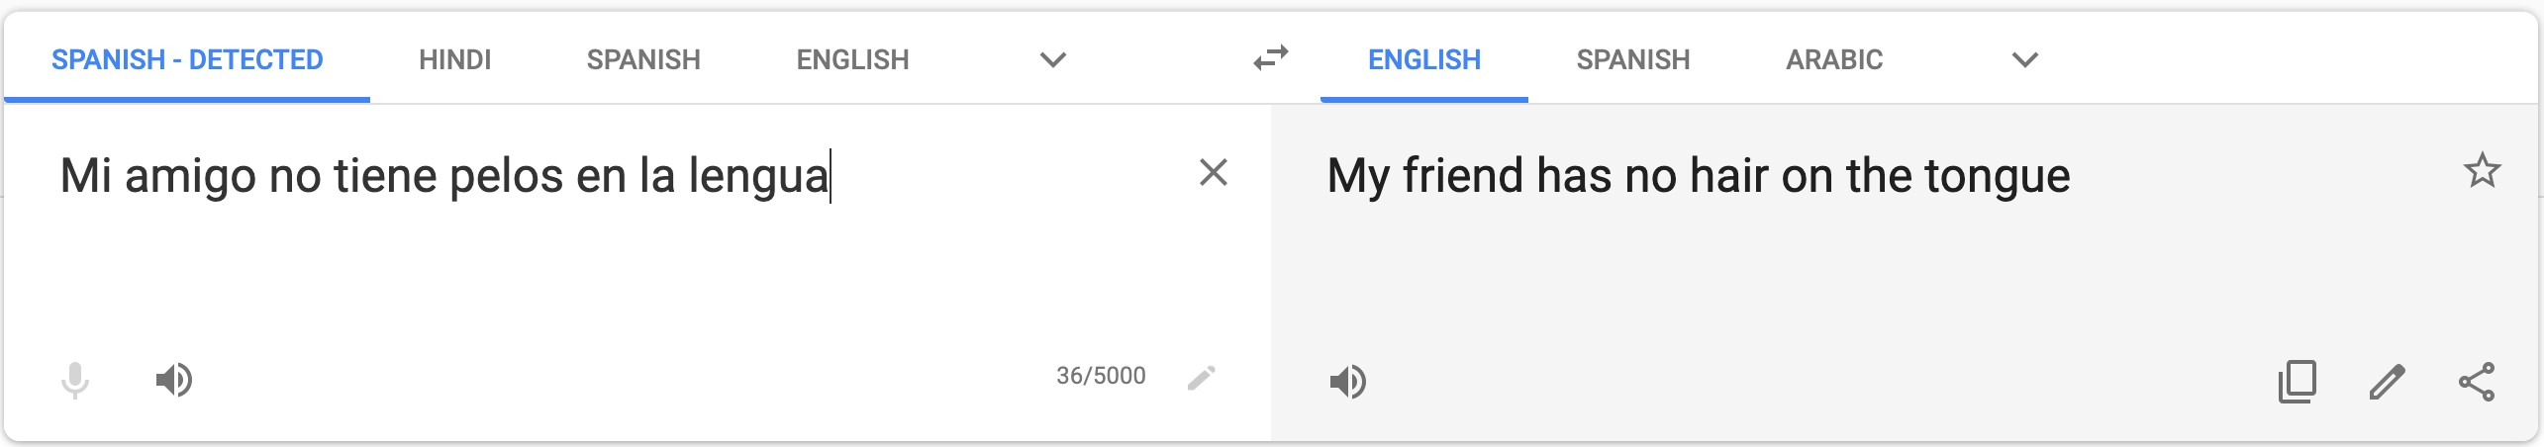
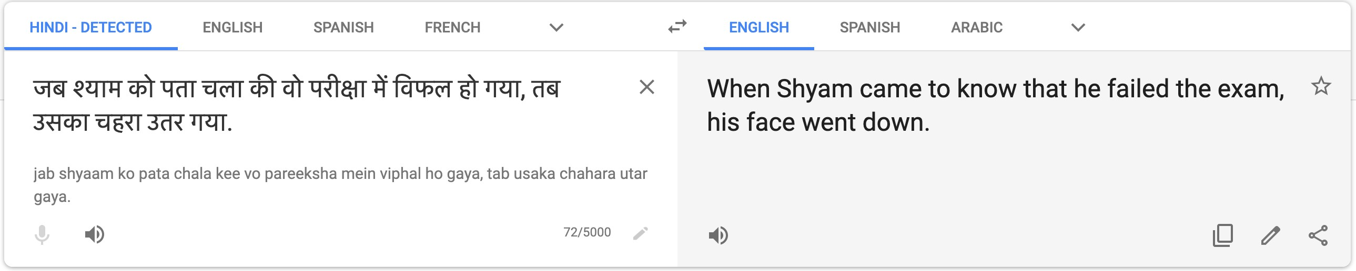
So is Machine Translation solved?
•
•
•
Nope!
Using common sense is still hard Idioms are difficult to translate
51

Slide 52
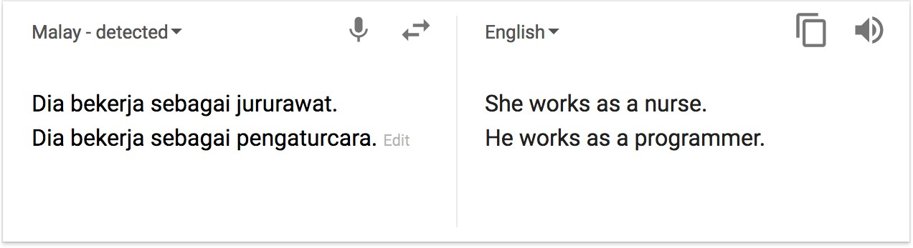
So is Machine Translation solved?
Nope!
NMT picks up biases in training data
Didn’t specify gender
52
Source: https://hackernoon.com/bias-sexist-or-this-is-the-way-it-should-be-
ce1f7c8c683c

Slide 53
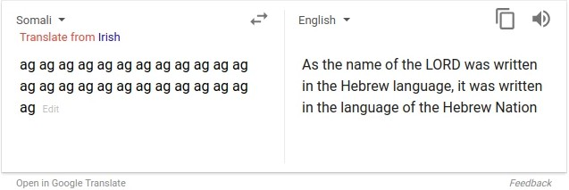
So is Machine Translation solved?
Nope!
Uninterpretable systems do strange things
Picture source: https://www.vice.com/en_uk/article/j5npeg/why-is-google-translate-spitting-out-sinister-
religious-prophecies
Explanation: https://www.skynettoday.com/briefs/google-nmt-prophecies
53

Slide 54
NMT research continues
NMT is the flagship task for NLP Deep Learning
NMT research has pioneered many of the recent innovations of NLP Deep Learning
In 2019: NMT research continues to thrive
Researchers have found many, many improvements to the “vanilla” seq2seq NMT system we’ve presented today
But one improvement is so integral that it is the new vanilla…
ATTENTION

Slide 55
Section 3: Attention

Slide 56
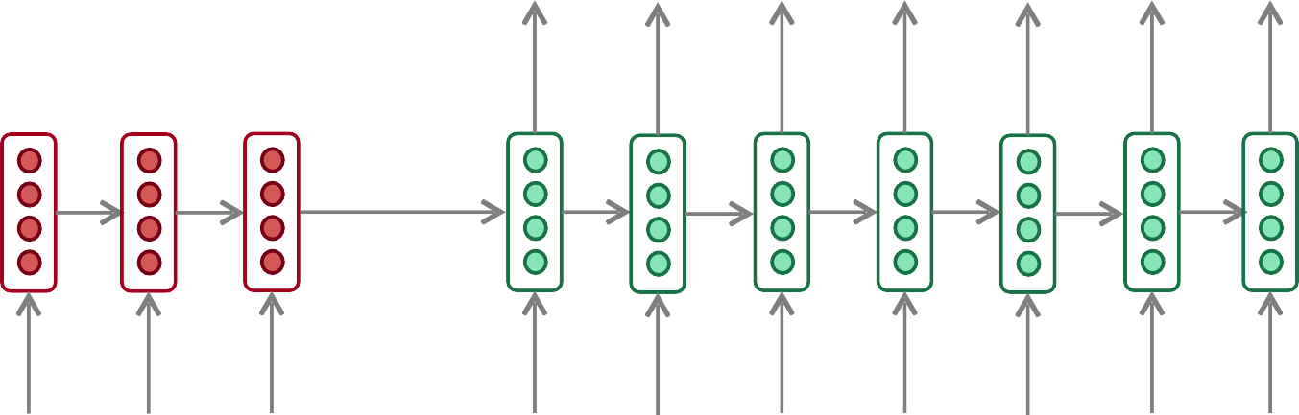
Sequence-to-sequence: the bottleneck problem
Encoding of the source sentence.
Target sentence (output)
he
hit me with a
pie <END>
Encoder RNN
Decoder RNN
il
a
m’ entarté
<START>
he hit me
with a
pie
Source sentence (input)
Problems with this architecture?

Slide 57
Sequence-to-sequence: the bottleneck problem
Encoding of the source sentence.
This needs to capture all information about the source sentence.
Information bottleneck!
Target sentence (output)
he
<END>
hit
me
with
a
pie
Encoder RNN
Decoder RNN
il entarté
a
m’
<START> he
pie
hit
me
with
a
Source sentence (input)

Slide 58

Attention
Attention provides a solution to the bottleneck problem.
Core idea: on each step of the decoder, use direct connection to the encoder to focus on a particular part of the source sequence
First we will show via diagram (no equations), then we will show with equations

Slide 59
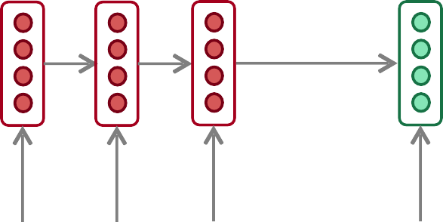
Sequence-to-sequence with attention
dot product
Attention scores
Decoder RNN
Encoder RNN
il
a m’ entarté
<START>
Source sentence (input)

Slide 60
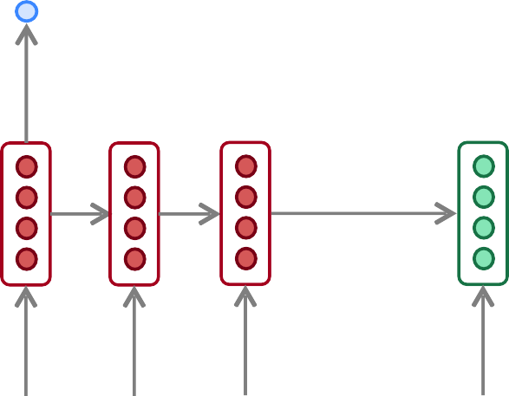
Sequence-to-sequence with attention
dot product
Attention scores
Decoder RNN
Encoder RNN
il
a
m’ entarté
<START>
Source sentence (input)

Slide 61
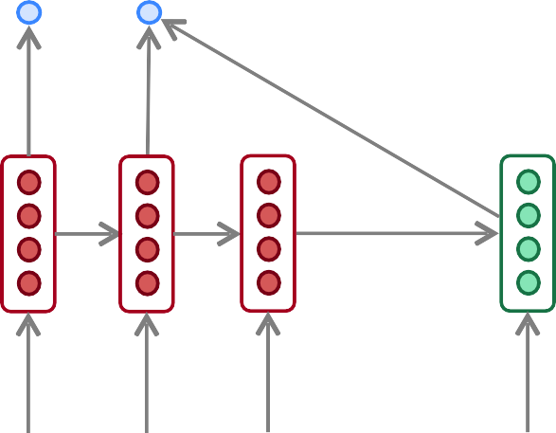
Sequence-to-sequence with attention
dot product
Attention scores
Decoder RNN
Encoder RNN
il
a m’ entarté
<START>
Source sentence (input)

Slide 62
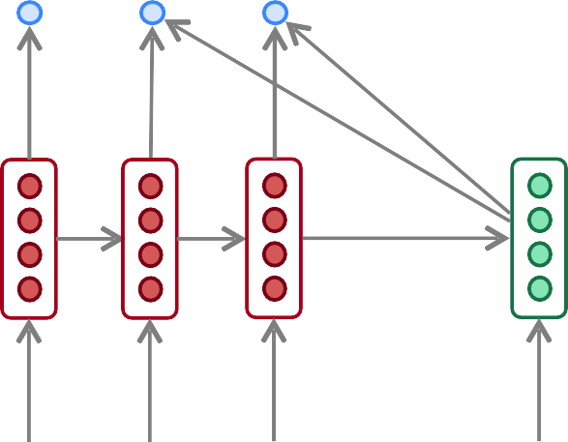
Sequence-to-sequence with attention
dot product
Attention scores
Decoder RNN
Encoder RNN
il
a m’ entarté
<START>
Source sentence (input)

Slide 63
Sequence-to-sequence with attention
On this decoder timestep, we’re mostly focusing on the first encoder hidden state (”he”)
Attention Attention
distribution
Take softmax to turn the scores into a probability distribution
scores
Decoder RNN
Encoder RNN
il
a m’ entarté
<START>
Source sentence (input)

Slide 64
Sequence-to-sequence with attention
Attention output
Use the attention distribution to take a weighted sum of the encoder hidden states.
Attention Attention
distribution
The attention output mostly contains information from the hidden states that received high attention.
scores
Decoder RNN
Encoder RNN
il
a m’ entarté
<START>
Source sentence (input)

Slide 65
Sequence-to-sequence with attention
Attention output
he
Concatenate attention output with decoder hidden state, then use to compute as before
distribution
_{𝑦}^
Attention Attention
1
scores
Decoder RNN
Encoder RNN
il
a m’ entarté
<START>
Source sentence (input)

Slide 66
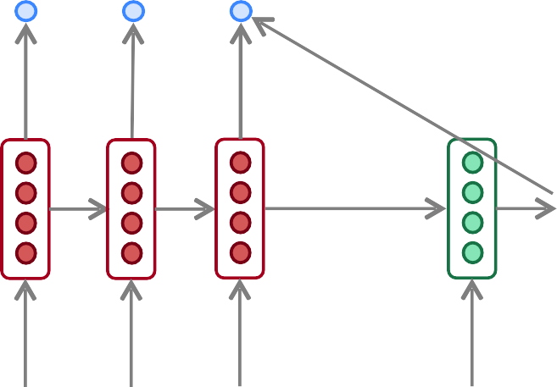
Sequence-to-sequence with attention
Attention output
hit
Attention Attention
distribution
_{𝑦}^₂
scores
Decoder RNN
Encoder RNN
Sometimes we take the attention output from the previous step, and also feed it into the decoder (along with the usual decoder input).
We do this in Assignment 4.
il a m’ entarté
Source sentence (input)
<START> he
66

Slide 67
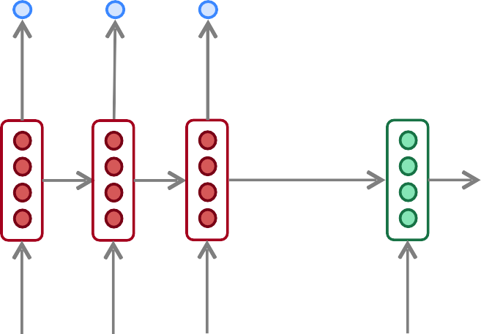
Sequence-to-sequence with attention
Attention output
me
distribution
_{𝑦}^₃
Attention Attention
scores
Decoder RNN
Encoder RNN
il
a
m’ entarté
<START> he hit
Source sentence (input)

Slide 68
Sequence-to-sequence with attention
Attention output
with
distribution
_{𝑦}^₄
Attention Attention
scores
Decoder RNN
Encoder RNN
il
a
m’ entarté
<START> he
hit me
Source sentence (input)

Slide 69
Sequence-to-sequence with attention
Attention output
a
distribution
_{𝑦}^₅
Attention Attention
scores
Decoder RNN
Encoder RNN
il
a m’ entarté
<START> he
hit me with
Source sentence (input)

Slide 70
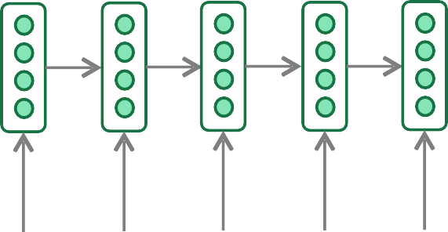
Sequence-to-sequence with attention
Attention output
pie
distribution
_{𝑦}^₆
Attention Attention
scores
Decoder RNN
Encoder RNN
il
a m’ entarté
<START> he
hit me with
a
Source sentence (input)

Slide 71
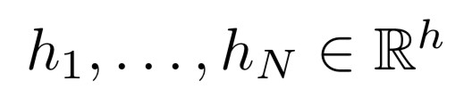
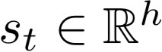
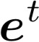
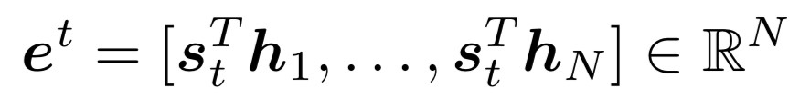
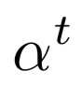
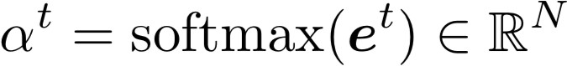
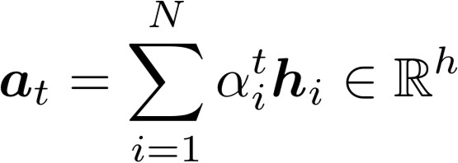
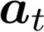
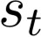
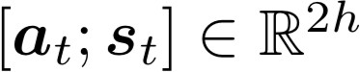
Attention: in equations
We have encoder hidden states
On timestep t, we have decoder hidden state
We get the attention scores for this step:
We take softmax to get the attention distribution (this is a probability distribution and sums to 1)
for this step
We use to take a weighted sum of the encoder hidden states to get the attention output
Finally we concatenate the attention output with the decoder hidden state and proceed as in the non-attention seq2seq model

Slide 72
Attention is great
Attention significantly improves NMT performance
It’s very useful to allow decoder to focus on certain parts of the source
Attention solves the bottleneck problem
Attention allows decoder to look directly at source; bypass bottleneck
Attention helps with vanishing gradient problem
Provides shortcut to faraway states
Attention provides some interpretability
By inspecting attention distribution, we can see
•
he hit me wit a pie
h
what the decoder was focusing on
We get (soft) alignment for free!
This is cool because we never explicitly trained an alignment system
The network just learned alignment by itself
il
a m’ entarté

Slide 73
Attention is a general Deep Learning technique
We’ve seen that attention is a great way to improve the sequence-to-sequence model for Machine Translation.
However: You can use attention in many architectures (not just seq2seq) and many tasks (not just MT)
More general definition of attention:
Given a set of vector values, and a vector query, attention is a technique to compute a weighted sum of the values, dependent on the query.
We sometimes say that the query attends to the values.
For example, in the seq2seq + attention model, each decoder hidden state (query) attends to all the encoder hidden states (values).

Slide 74
Attention is a general Deep Learning technique
More general definition of attention:
Given a set of vector values, and a vector query, attention is a technique to compute a weighted sum of the values, dependent on the query.
Intuition:
The weighted sum is a selective summary of the information contained in the values, where the query determines which values to focus on.
Attention is a way to obtain a fixed-size representation of an arbitrary set of representations (the values), dependent on some other representation (the query).

Slide 75
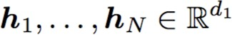
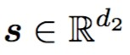
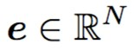
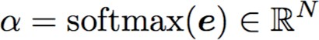

There are several attention variants
We have some values and a q
uery
Attention always involves:
Computing the attention scores
There are multiple ways to do this
2. Taking softmax to get attention distribution ⍺:
3. Using attention distribution to take weighted sum of values:
thus obtaining the attention output a (sometimes called the context vector)

Slide 76






Attention variants
You’ll think about the relative advantages/ disadvantages of these in Assignment 4!
There are several ways you can comp and :
Basic dot-product attention:
Note: this assumes
This is the version we saw earlier
ute
from
Multiplicative attention:
Where
Additive attention:
Where
is a weight vector.
is a weight matrix
are weight matrices
and
d₃ (the attention dimensionality) is a hyperparameter
More information:
“Deep Learning for NLP Best Practices”, Ruder, 2017. http://ruder.io/deep-learning-nlp-best-practices/
index.html#attention “Massive Exploration of Neural Machine Translation Architectures”, Britz et al, 2017, https://arxiv.org/pdf/
1703.03906.pdf
76

Slide 77

Summary of today’s lecture
We learned some history of Machine Translation (MT)
Since 2014, Neural MT rapidly replaced intricate Statistical MT
Sequence-to-sequence is the architecture for NMT (uses 2 RNNs)
Attention is a way to focus on particular parts of the input
Improves sequence-to-sequence a lo
77
t!

